Slide 1
Vertical Farming
Ambient Intelligence
Bauyrzhan Zhakanov

Slide 2
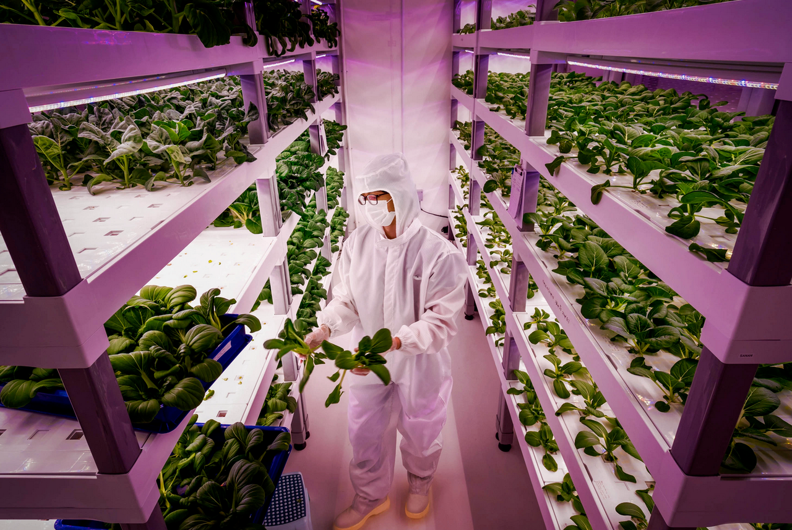
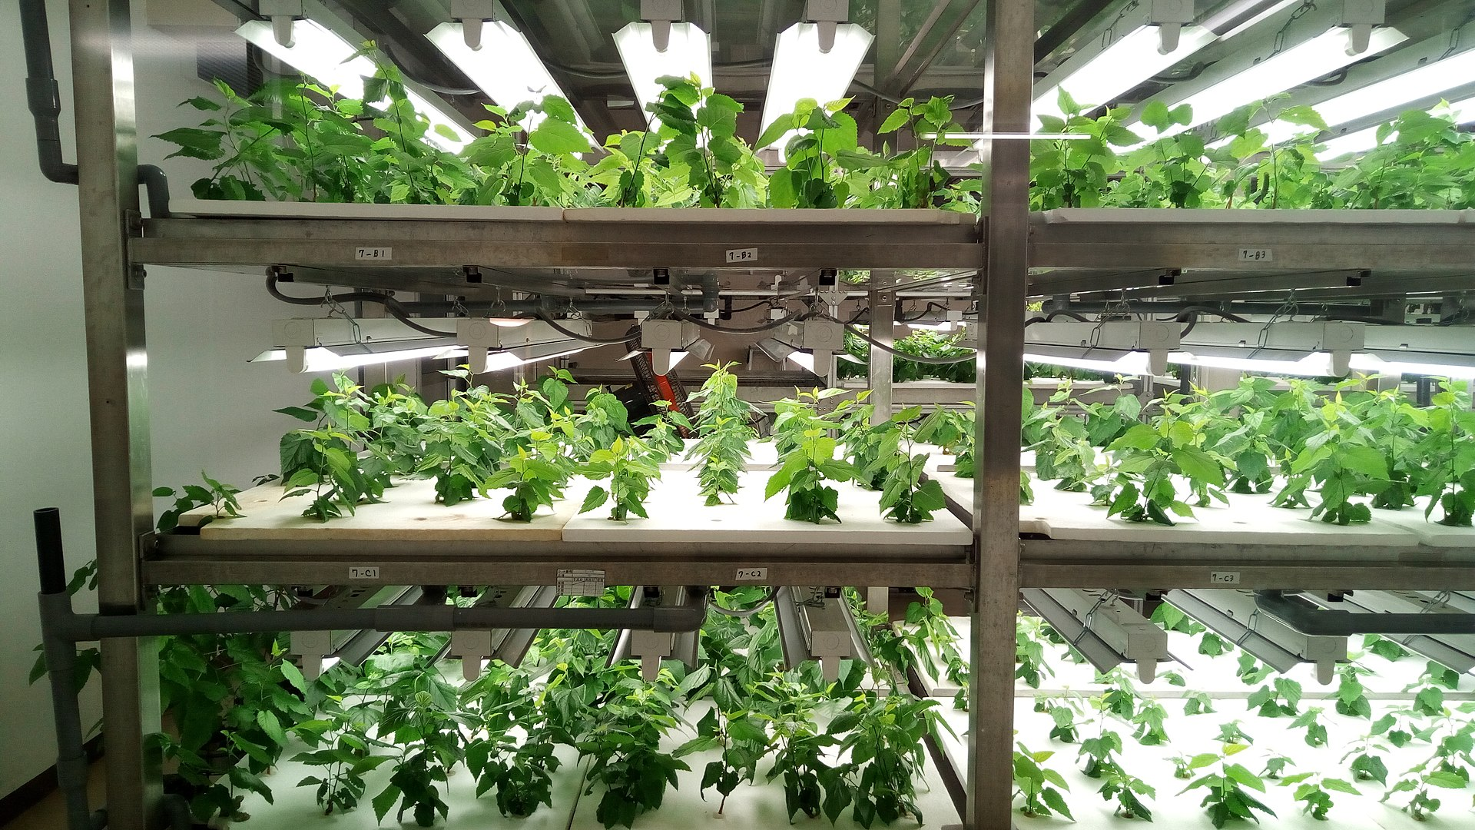
Introduction
Vertical farming is the practice of growing crops in vertically stacked layers.
This is often incorporated by the controlled-environment agriculture, which aims to optimize plant growth, and soilless farming techniques such as hydroponics, aquaponics, and aeroponics.

Slide 3
Human Interaction to the Vertical Farming
If a plant is ready for yield, then human will take the plant
If a sensor of the system is damaged, then an engineer will fix the issue
If a water tank for Vertical Farming is empty, then a human will be involved to fill the water
If a plant has a disease, then a human will be involved to remove this plant

